Slide 1
Project Presentation
----Ebb & Flo project
Group : 8
Members: Ming Qi Bi, Ming Pan, Yang Cao and Yingjie Jia

Slide 2
Research Questions
The goal for the company is to build a template, guide, and deployment of AI models to integrate into a telehealth app, starting with endometriosis, a disease that affects 11% of the female population, a number well over 6 million.
Build a side by side competitive model that can accurately predict diagnostic results based on the collected data and also make a real-world deployment which can generate test cases.
Normally endometriosis can take years to diagnose.
Our diagnostic engine can get the diagnosis time down to a few minutes.

Slide 3
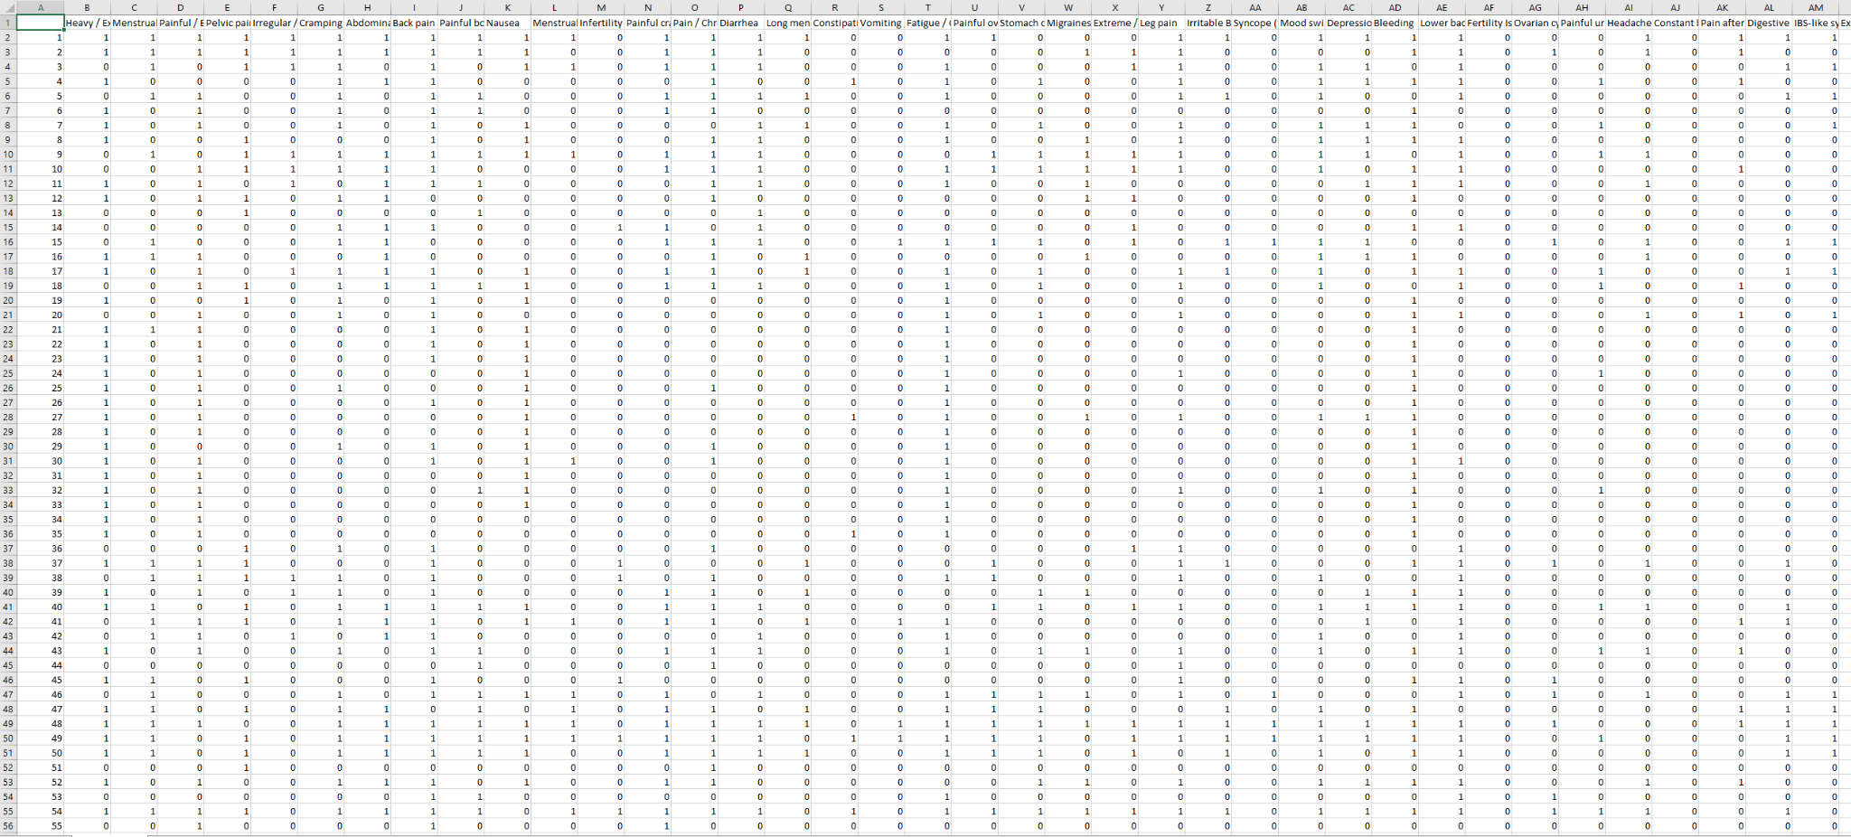
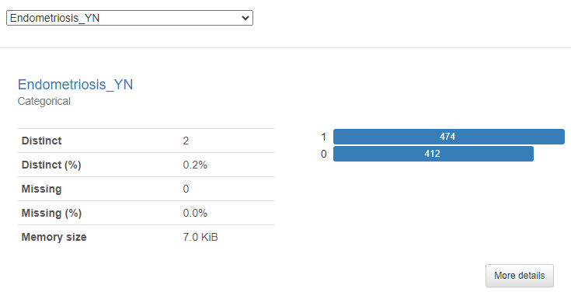
Dataset Description
Dataset Description

Slide 4
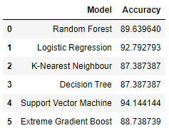
Model Design
Model Class: Supervised learning
All instances in the given dataset are labeled
To predict an accurate outcome
Algorithms: Random Forest, Logistic Regression, KNN, Decision Tree, SVM, Extreme Gradient Boost
We choose: Random Forest
Less over-fitting
Major application in healthcare and medicine fields

Slide 5
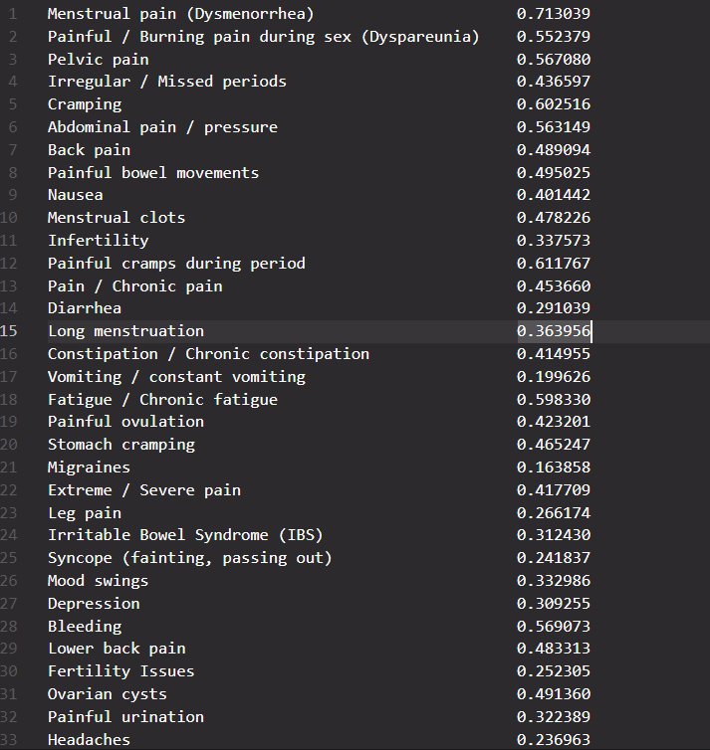
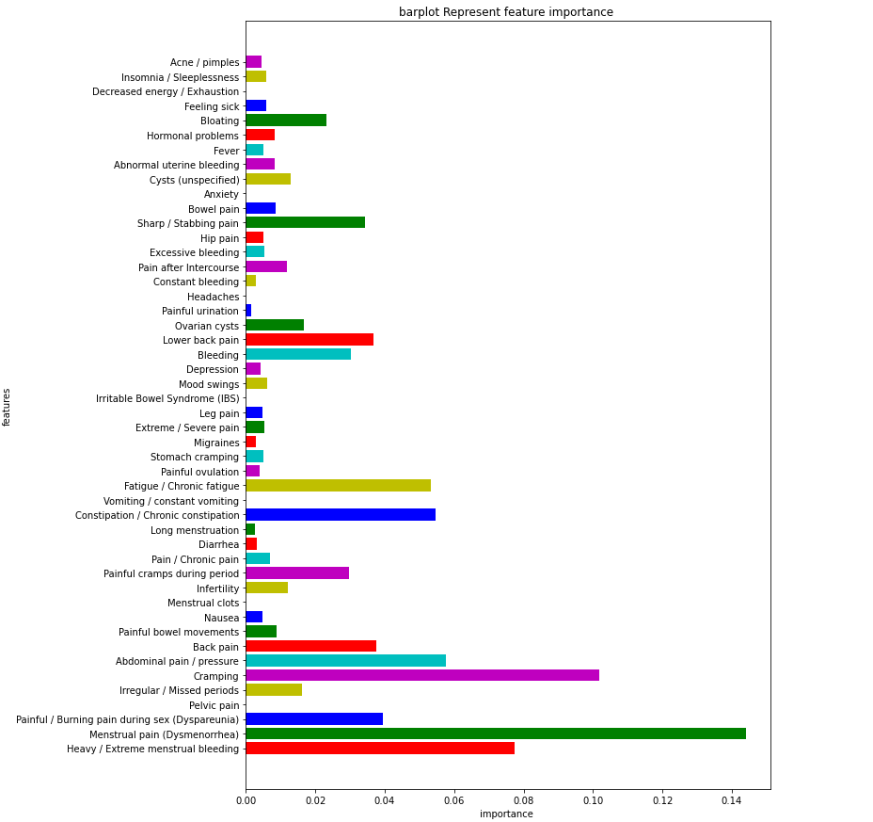
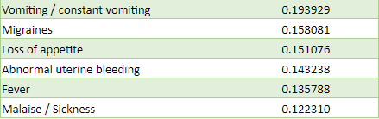
Feature importance

Slide 6
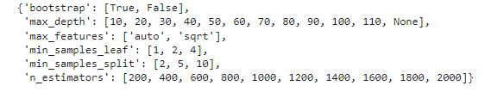
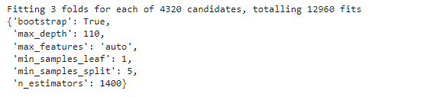
Model Design
Parameter grid
Best parameters for hyperparameter tuning

Slide 7
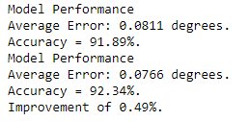
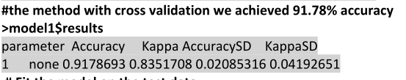

Result
RandomizedSearch
GridSearch
Current model in R programming language(Logistic Regression)

Slide 8
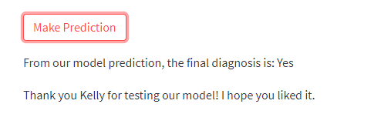
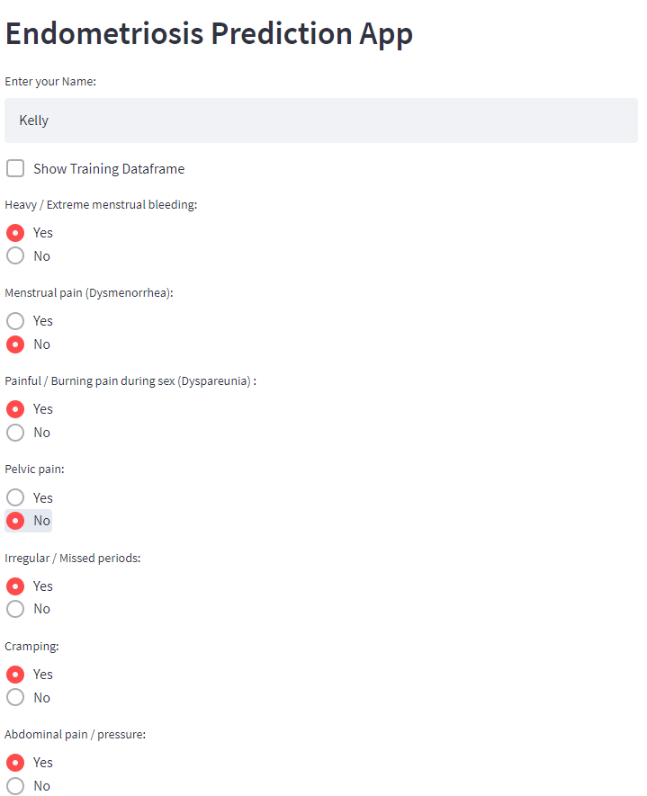
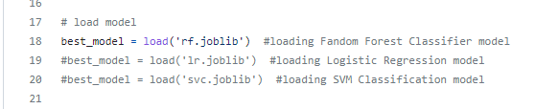
Real-world Deployment
https://maxime-pan-soen471-main-pas2g7.streamlit.app/
https://github.com/itshisher/SOEN471/blob/main/main.py

Slide 9
Conclusion and discussion
RandomizedSearch
GridSearch
Current model in R programming language(Logistic Regression)

Slide 10
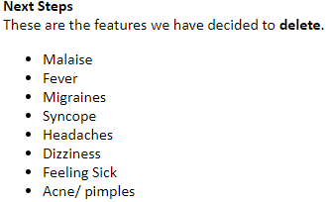
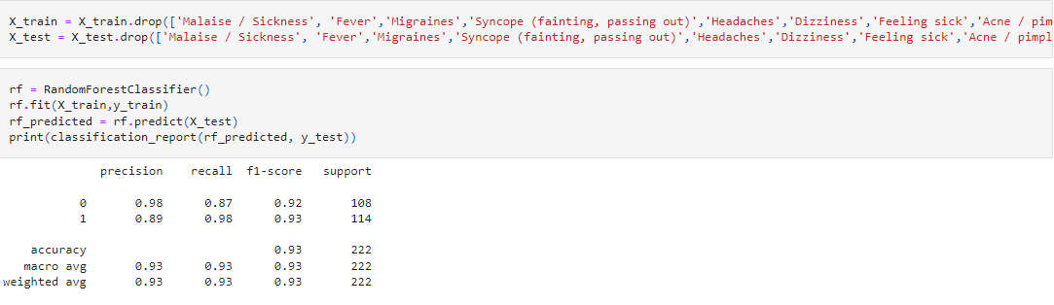
Conclusion and discussion
https://github.com/itshisher/SOEN471/blob/main/Project_Sympton_Tracker.ipynb

